Slide 1
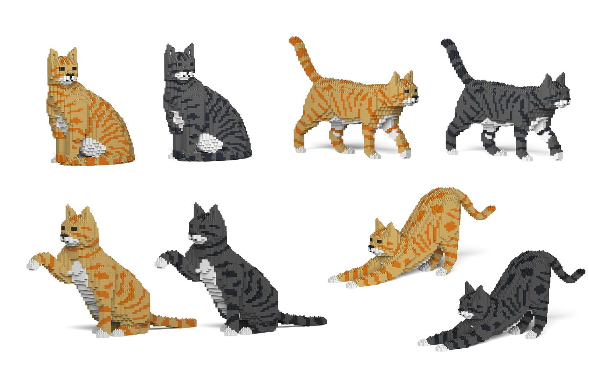
Basic Computer Programming
Introduction
Lunafreya Celestine <3

Slide 2
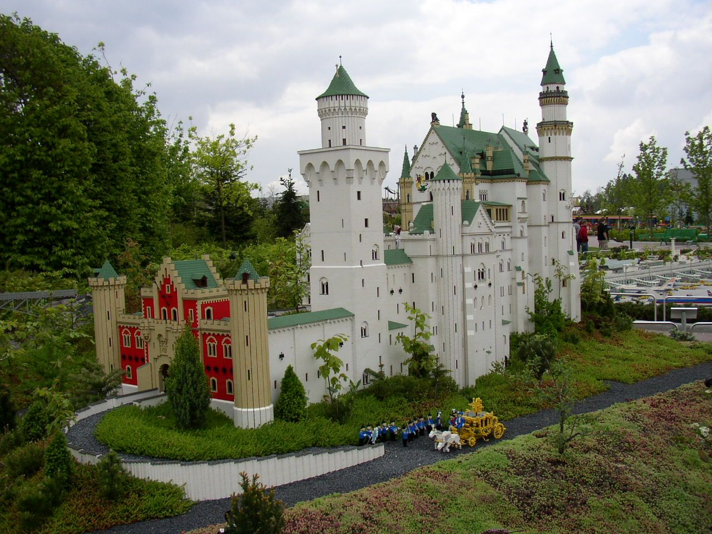
Shit To Go Over
Basic Computer Architecture
Programming Languages
Interpreted vs Compiled
Development Environments
Data Types
Variables
Syntax
Functions
Library & Frameworks

Slide 3

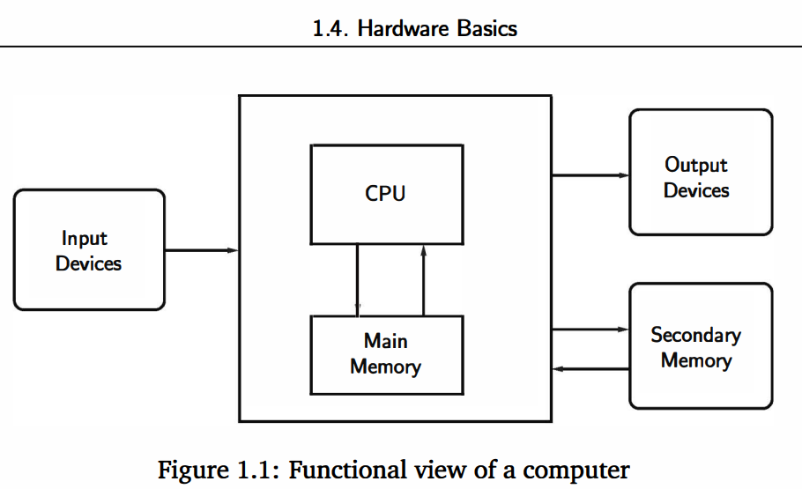
Computer Architecture
Intel
Amd
etc...
Display
Speakers
Mouse
Keyboard
Microphone
Touchpad
Game Controller
Hard Drive
RAM

Slide 4

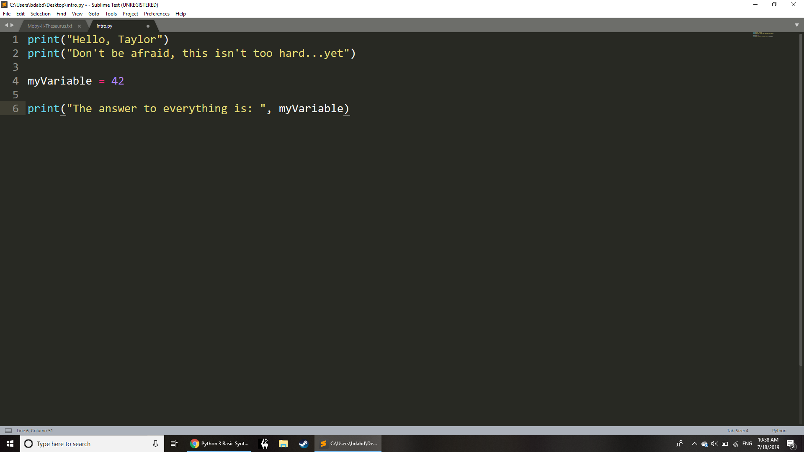
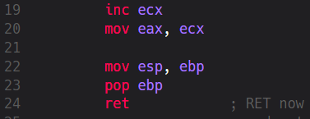
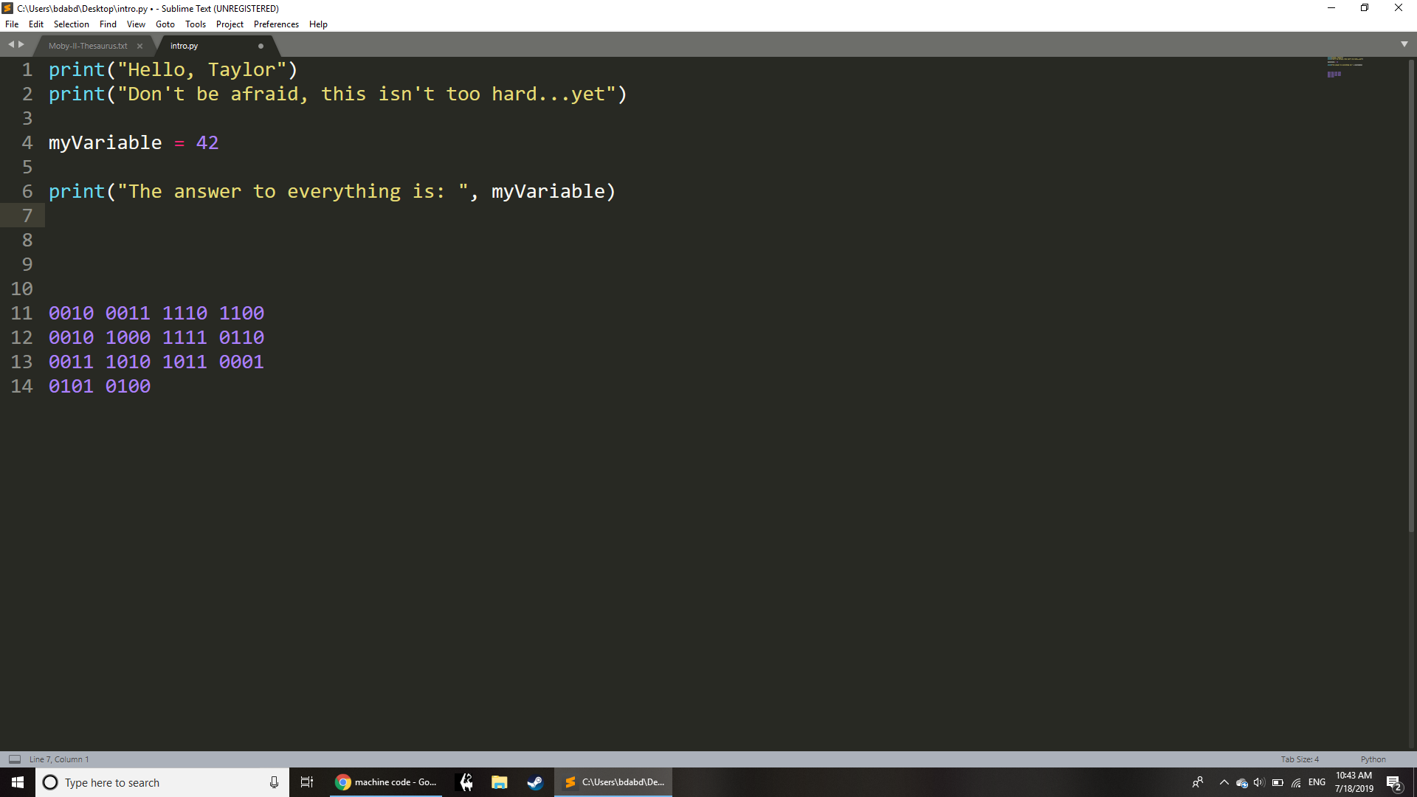
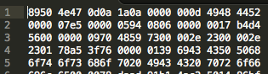
Programming Languages
Specific to CPU Type
Source Code
Assembly
Readable by humans
Binary
Hexadecimal
Readable by machines
A sort of binary shorthand

Slide 5

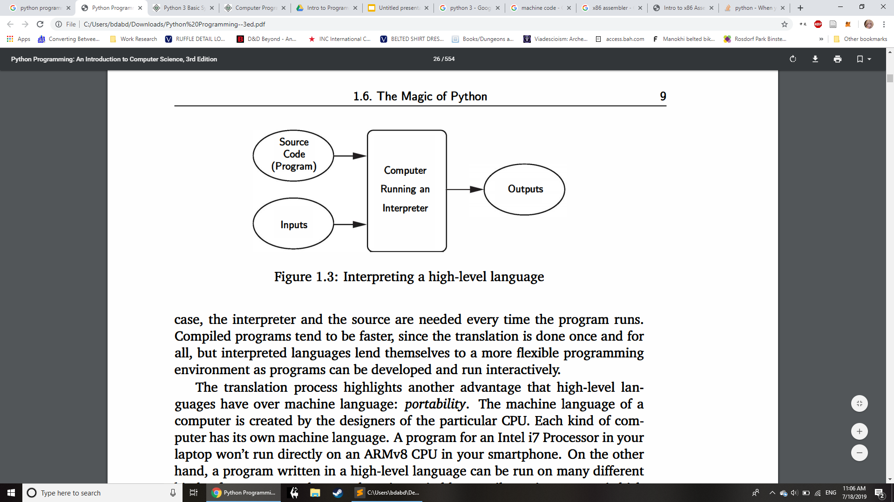
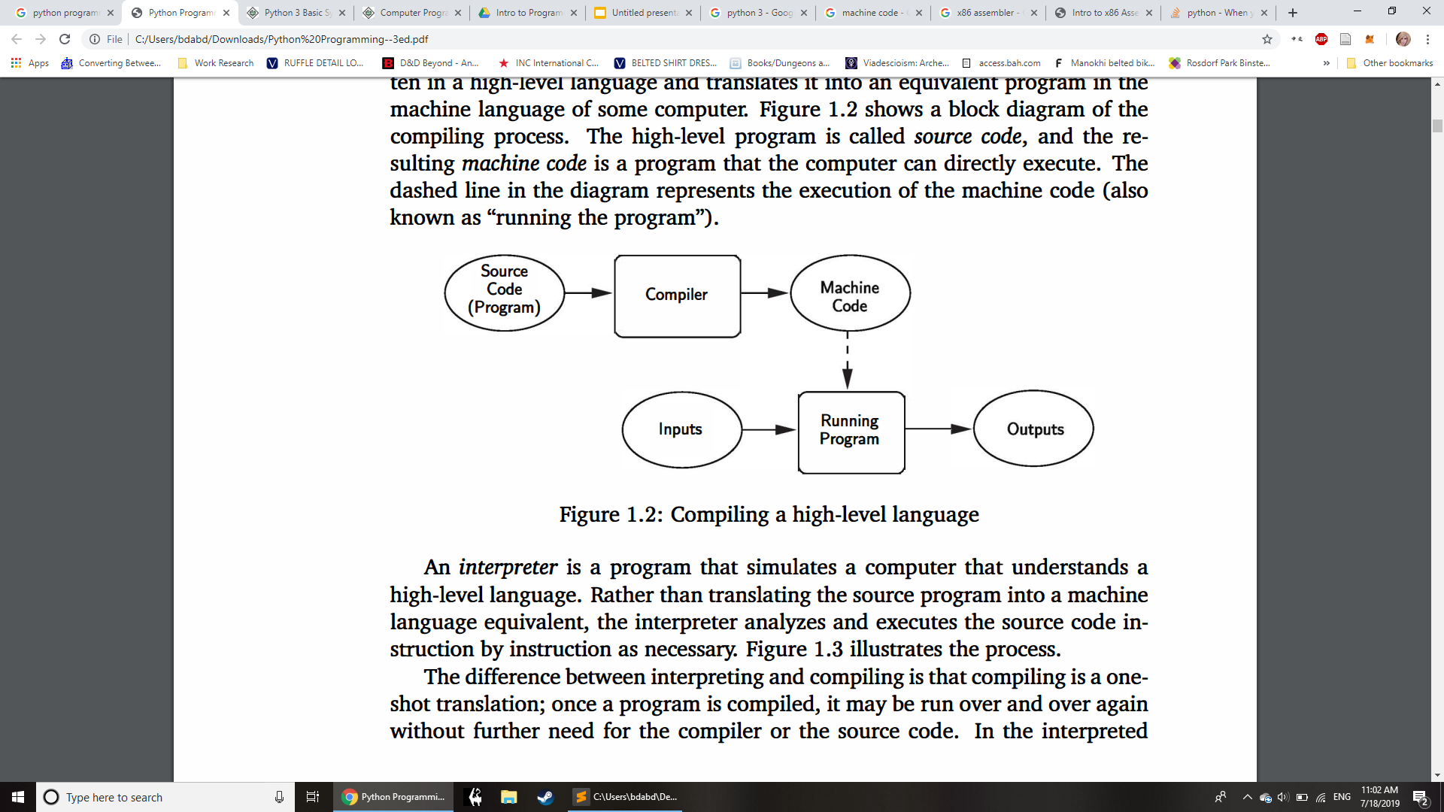
Interpreted vs Compiled
Typically runs slower
Good for developing prototypes
Often has more english-like syntax
Can be written from a file
Can be run line by line in the command line
Typically runs faster
Less portable between computers
Needs to be recompiled whenever transferred to different machine
More verbose syntax
Must be Saved -> Compiled -> Run
Examples:
Python
Lisp
Examples:
C++
C

Slide 6
Interpreted vs Compiled
Typically runs slower
Good for developing prototypes
Often has more english-like syntax
Can be written from a file
Can be run line by line in the command line
Typically runs faster
Less portable between computers
Needs to be recompiled whenever transferred to different machine
More verbose syntax
Must be Saved -> Compiled -> Run
Interpreted
Compiled

Slide 7



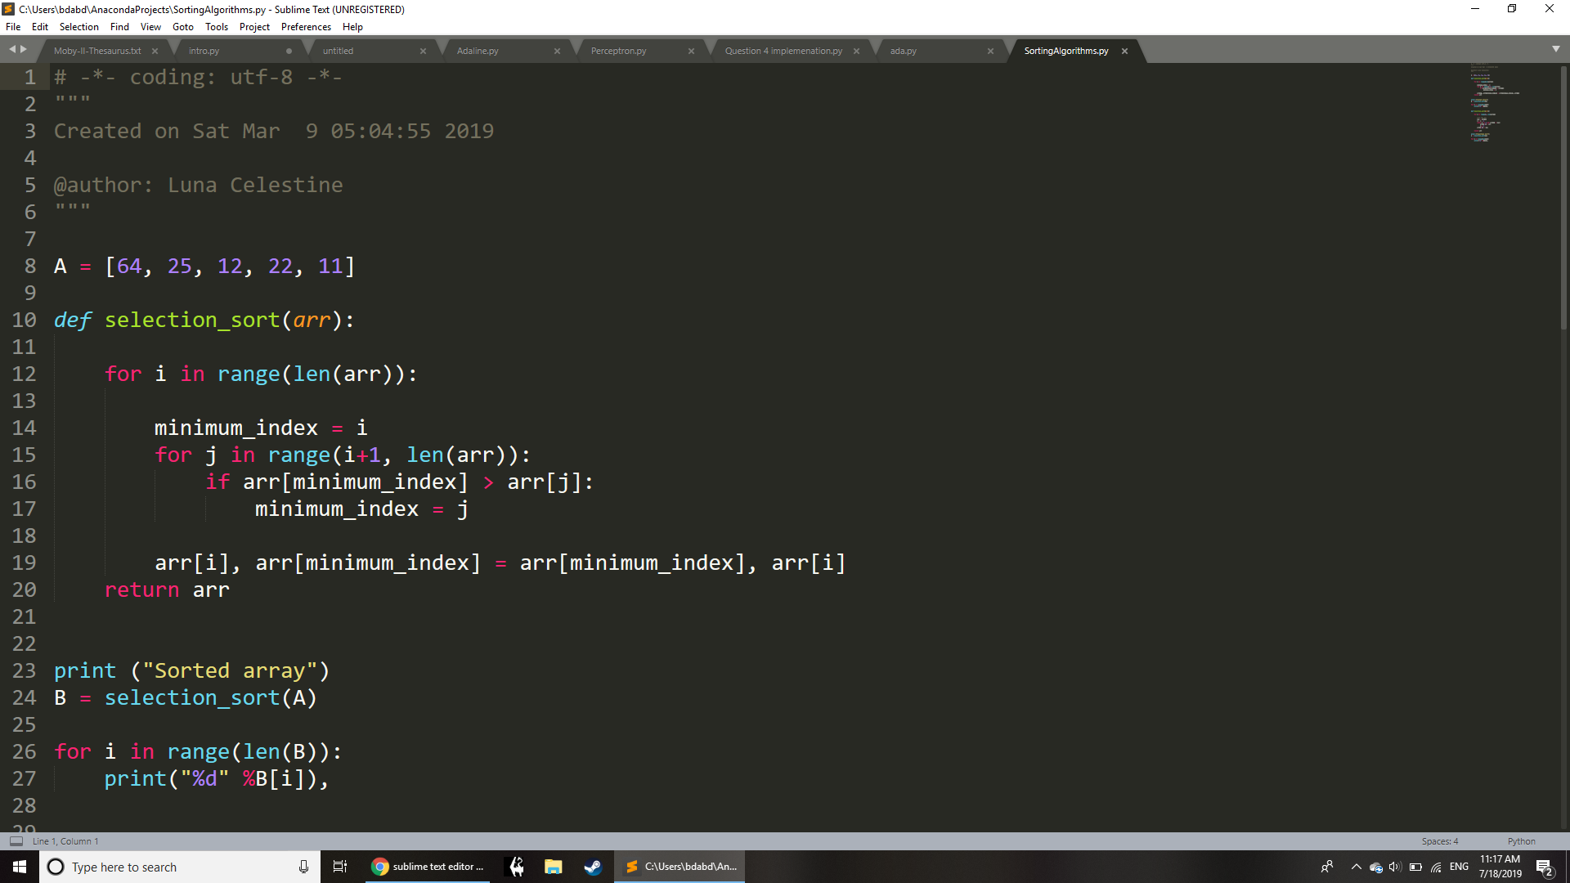
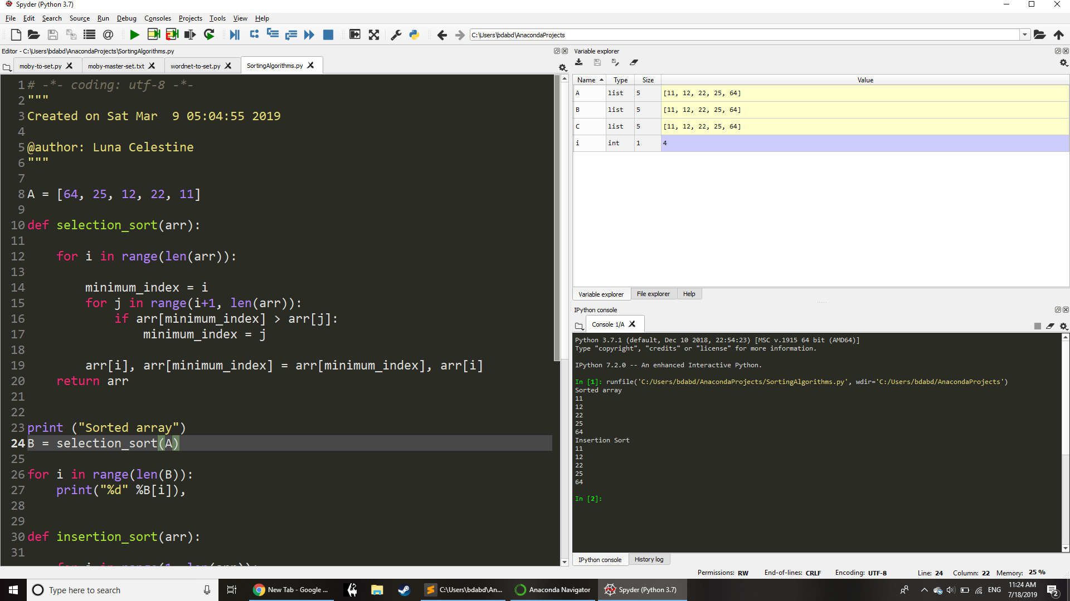
Development Enviroments
Sublime Text Editor
Spyder Interactive Development Environment

Slide 8
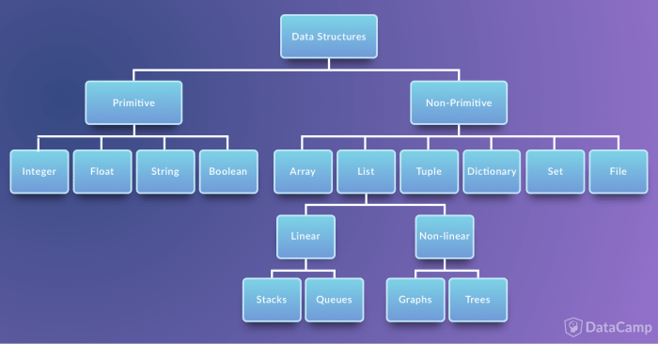
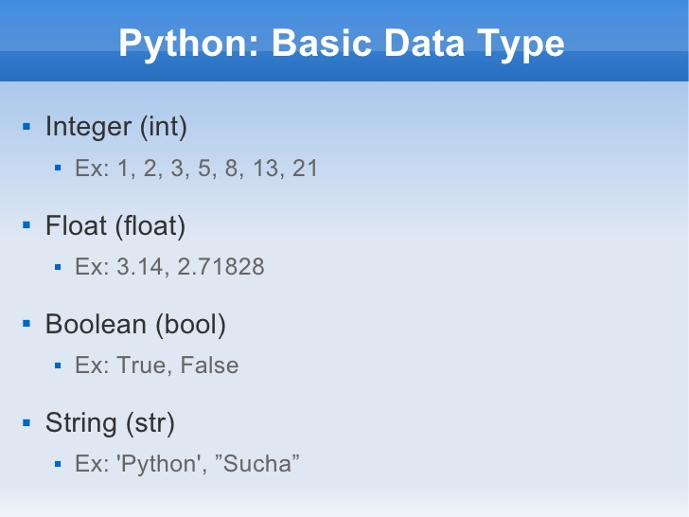
Data Types

Slide 9
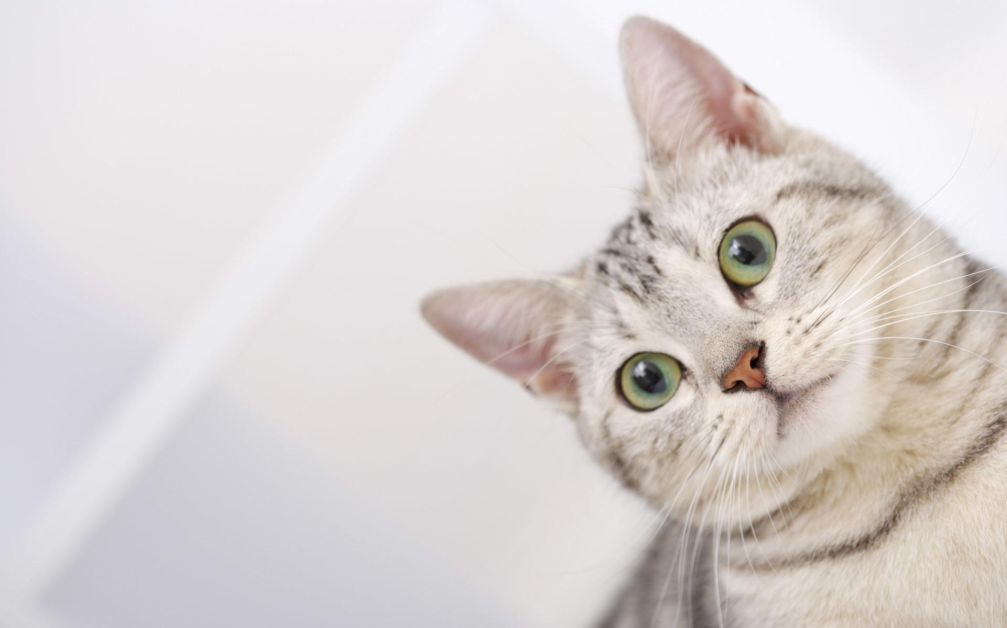
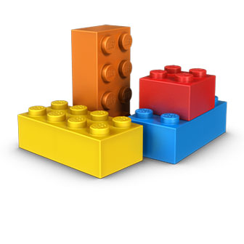
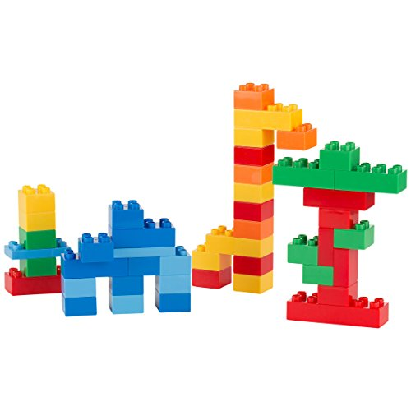
Data Types
lolwut?
Primitive Types
FLOAT
INT
BOOLEAN
STRING
Data Structures

Slide 10
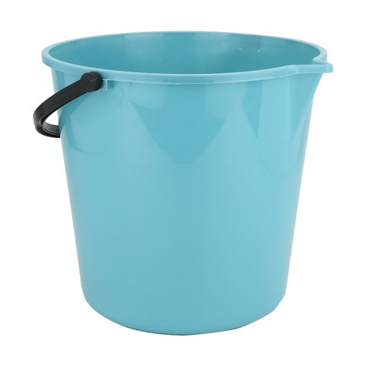
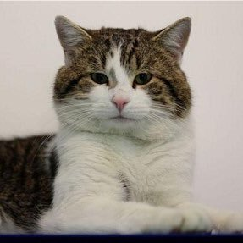
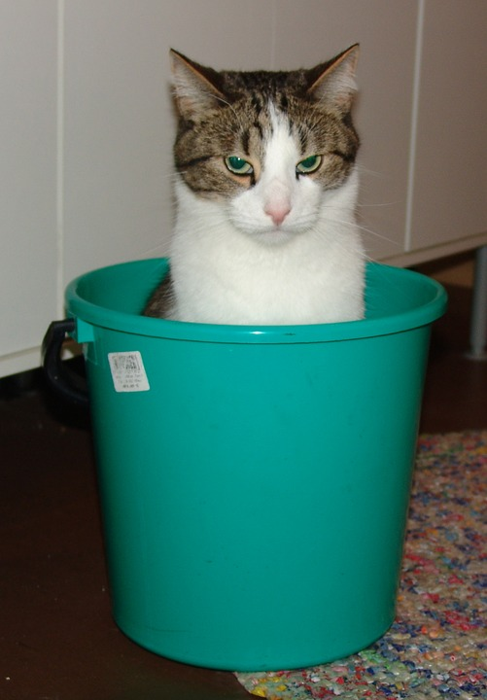
Variables
Value Assigned to Variable
Variable
Value
Caution:
For Cats Only

Slide 11

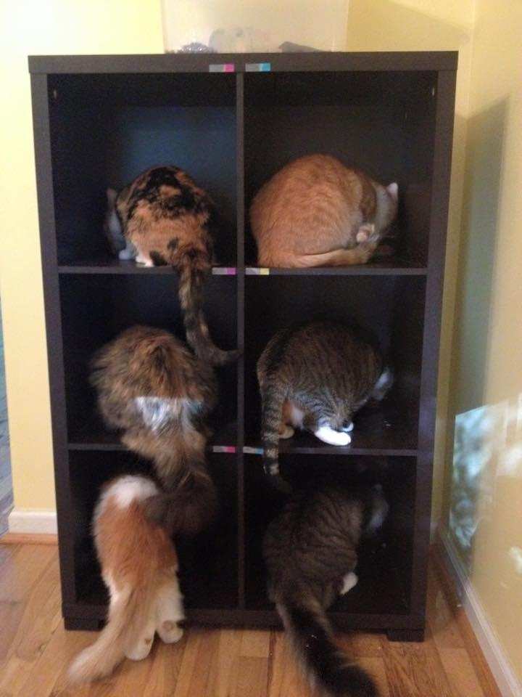
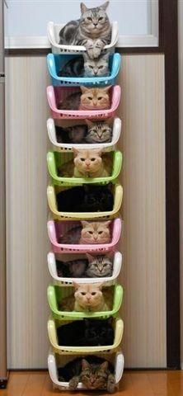
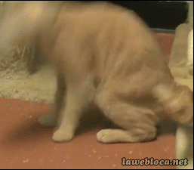
Variables
Values Assigned to Variables in Data Structures
TyperError: expected liquid, got cat

Slide 12
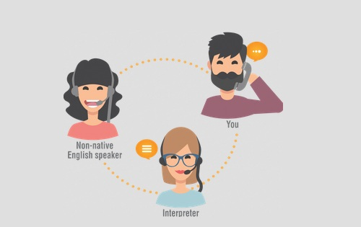
Syntax
Much like grammar, syntax is important
01110111 01110100 01100110?
Chad
CPU
Source Code:
PSL’s? Their totes my fave
Compiler Error:
There’s no way I’m translating that, Chad.
Interpreter / Compiler

Slide 13
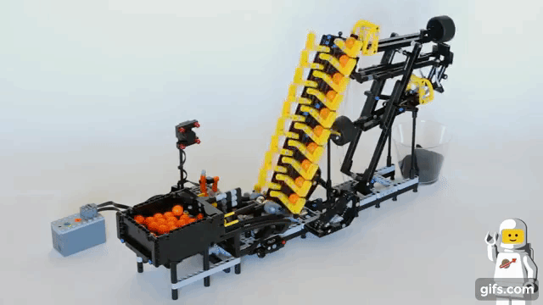
Functions
Function
Outputs
Inputs
Notes:
Function multiplyByTwo( number1){
number2 = number1 * 2
Return number2
}
1 == 1
1 != 2

Slide 14
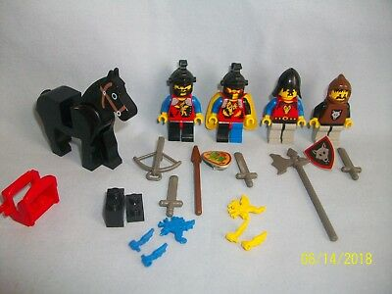
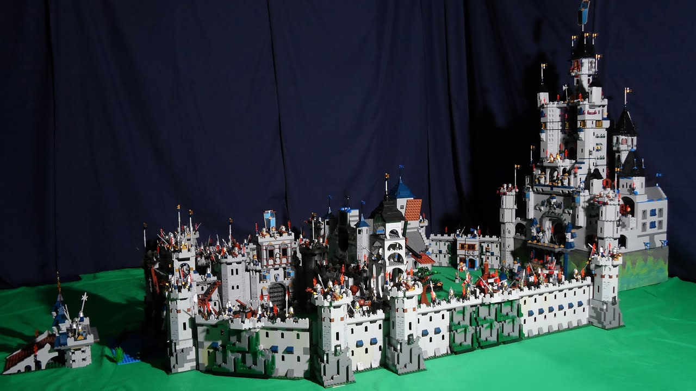
Libraries and Frameworks
Libraries
You use various pieces of the library in your code
Frameworks
Your code runs inside of the framework

Slide 15
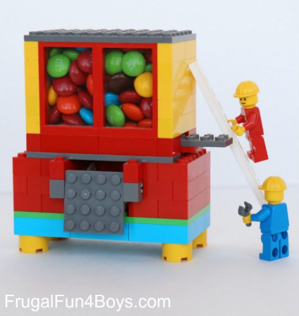
Application Programming Interface
Dude, check this thing out!!1 this thing dispenses M&M’s the size of my head!
This could change the way we build castles altogether! If only we could unlock its secrets...

Slide 16
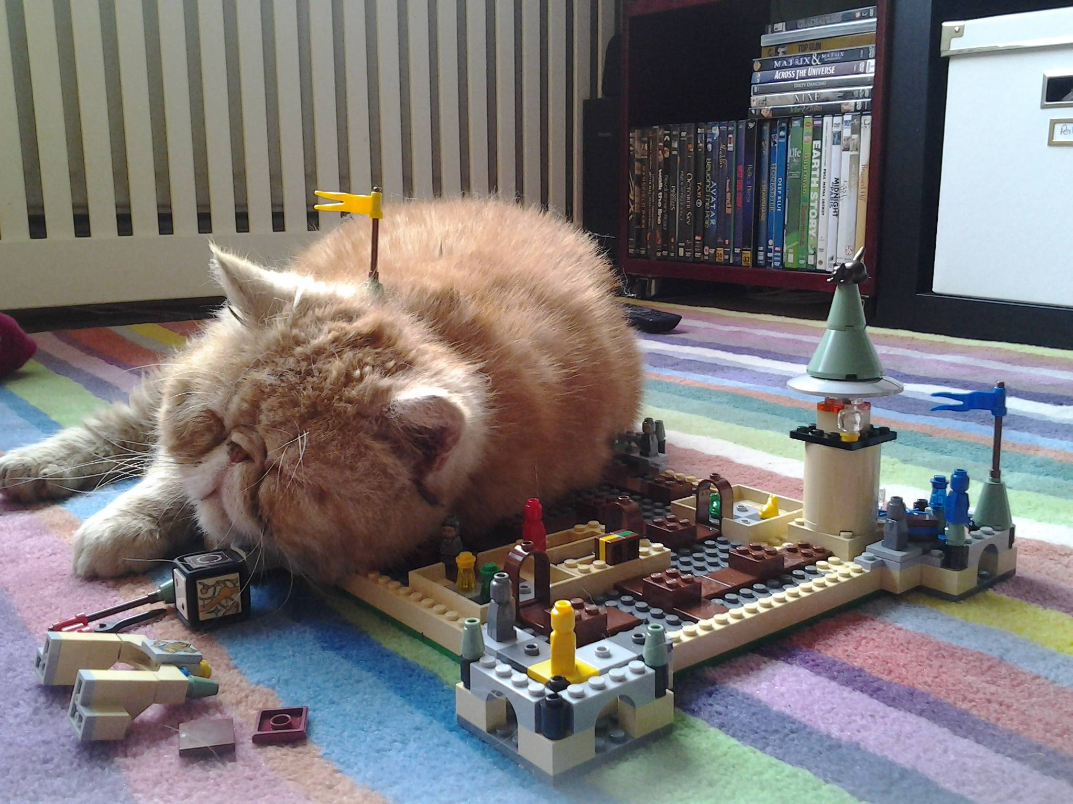
Go forth and do great things!
Notes:
Add char 1 2 #
Text heavy in the beginning
Jvm diagram
Examples for functions, variables etc in java python and 1 more language
Assignment, negations, equality operators
glossary

